Slide 1
The Atlung Method for Intercalant Diffusion and Resistance (AMIDR) A Complete Pulse Method for Measuring Cathode Solid-State Diffusivity
AMIDR = Sequel to AMID

Slide 2
Cell Impedance
e⁻ wire
Li⁺ electrolyte @ cathode
Li⁺ electrolyte @ anode
Cathode
Li⁺ cathode diffusion
Li⁺ anode diffusion
Anode
Li⁺ cathode interface
Li⁺ anode interface
e⁻ cathode
Li⁺ electrolyte @ separator
e⁻ anode
Impedance can come from many parts of the cell
Impedance limits power density (and energy density if capacity is kinetically hindered)
Cathode active material is AMIDR’s focus

Slide 3
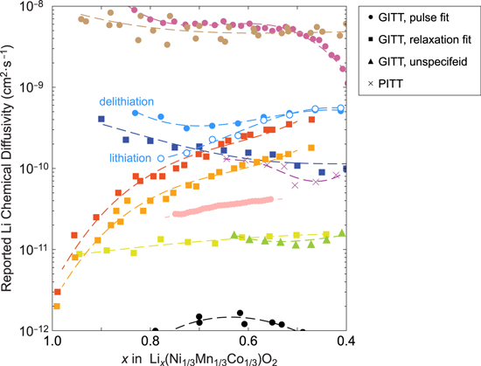
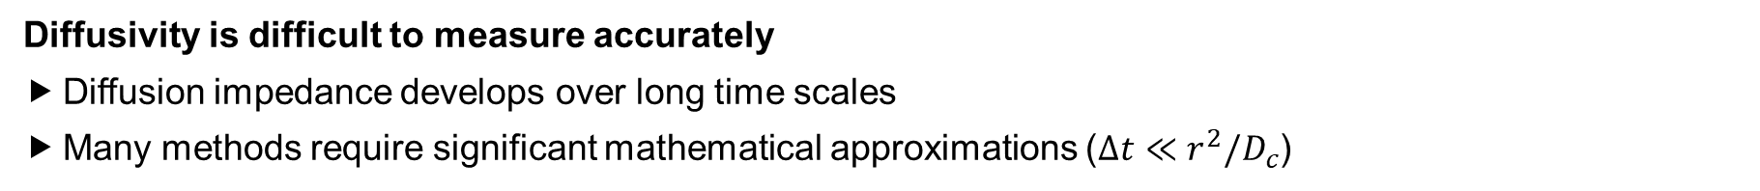
Diffusivity Reproducibility
Interface
Diffusion
Diffusivity is difficult to measure accurately
Diffusion impedance develops over long time scales
Many methods require significant mathematical approximations ($∆t≪r^{2}/D_{c}$)
Figure adapted from [1] S. Kang and W. Chueh, “GITT Reinvented” J. Electrohem. Soc., 168, 120504 (2021)

Slide 4

How to Measure Diffusivity Accurately
Ultra-low Mass Loading
High Sampling Rate
Shielding
Model
Resistance Inclusion
Reference Electrode
Rapid Pulse Initiation
“Complete” Finite-volume
Cell Design
Cell Tester
Normalized Error
Error Management
Protocol
“Incomplete” Pulse Detection
Side Reaction Detection
“Complete” Pulses/Rests
Small V Limit Pulses
Charge/Discharge Agreement
Inconsistent $dq/dV$ Detection
Logarithmic Sampling
Everything needs to be done right for accurate diffusivity measurements
“A chain is only as strong as its weakest link”
AMIDR does nearly all of it for you (available at github.com/MitchBall/AMIDR)

Slide 5
Cell Design
e⁻ wire
Li⁺ electrolyte @ cathode
Li⁺ electrolyte @ anode
Cathode
Li⁺ cathode diffusion
Li⁺ anode diffusion
Anode
Li⁺ cathode interface
Li⁺ anode interface
e⁻ cathode
Li⁺ electrolyte @ separator
e⁻ anode
Intelligent cell design eliminates some sources of impedance and amplifies desired sources
Reference electrode (~0.31 V vs Li⁺/Li⁰) eliminates anode impedance
Ultra-low mass loading removes electrolyte @ cathode impedance and amplifies diffusion and interface

Slide 6
Cell Design
e⁻ wire
Li⁺ electrolyte @ cathode
Li⁺ electrolyte @ anode
Cathode
Li⁺ cathode diffusion
Li⁺ anode diffusion
Anode
Li⁺ cathode interface
Li⁺ anode interface
e⁻ cathode
Li⁺ electrolyte @ separator
e⁻ anode
Intelligent cell design eliminates some sources of impedance and amplifies desired sources
Reference electrode (~0.31 V vs Li⁺/Li⁰) eliminates anode impedance
Ultra-low mass loading removes electrolyte @ cathode impedance and amplifies diffusion and interface

Slide 7
Cell Design
e⁻ wire
Li⁺ electrolyte @ cathode
Li⁺ electrolyte @ anode
Cathode
Li⁺ cathode diffusion
Li⁺ anode diffusion
Anode
Li⁺ cathode interface
Li⁺ anode interface
e⁻ cathode
Li⁺ electrolyte @ separator
e⁻ anode
Intelligent cell design eliminates some sources of impedance and amplifies desired sources
Reference electrode (~0.31 V vs Li⁺/Li⁰) eliminates anode impedance
Ultra-low mass loading removes electrolyte @ cathode impedance and amplifies diffusion and interface

Slide 8
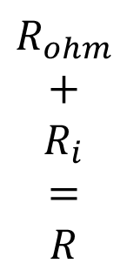



Cell Design
e⁻ wire
$$R_{ohm}$$
Li⁺ electrolyte @ cathode
Li⁺ electrolyte @ anode
$$R_{ohm}$$
$$+$$
$$R_{i}$$
$$=$$
$$R$$
Cathode
Li⁺ cathode diffusion
Li⁺ anode diffusion
Anode
$$D_{c}$$
Li⁺ cathode interface
Li⁺ anode interface
$$R_{i}$$
e⁻ cathode
Li⁺ electrolyte @ separator
e⁻ anode
Intelligent cell design eliminates some sources of impedance and amplifies desired sources
Reference electrode (~0.31 V vs Li⁺/Li⁰) eliminates anode impedance
Ultra-low mass loading removes electrolyte @ cathode impedance and amplifies diffusion and interface

Slide 9
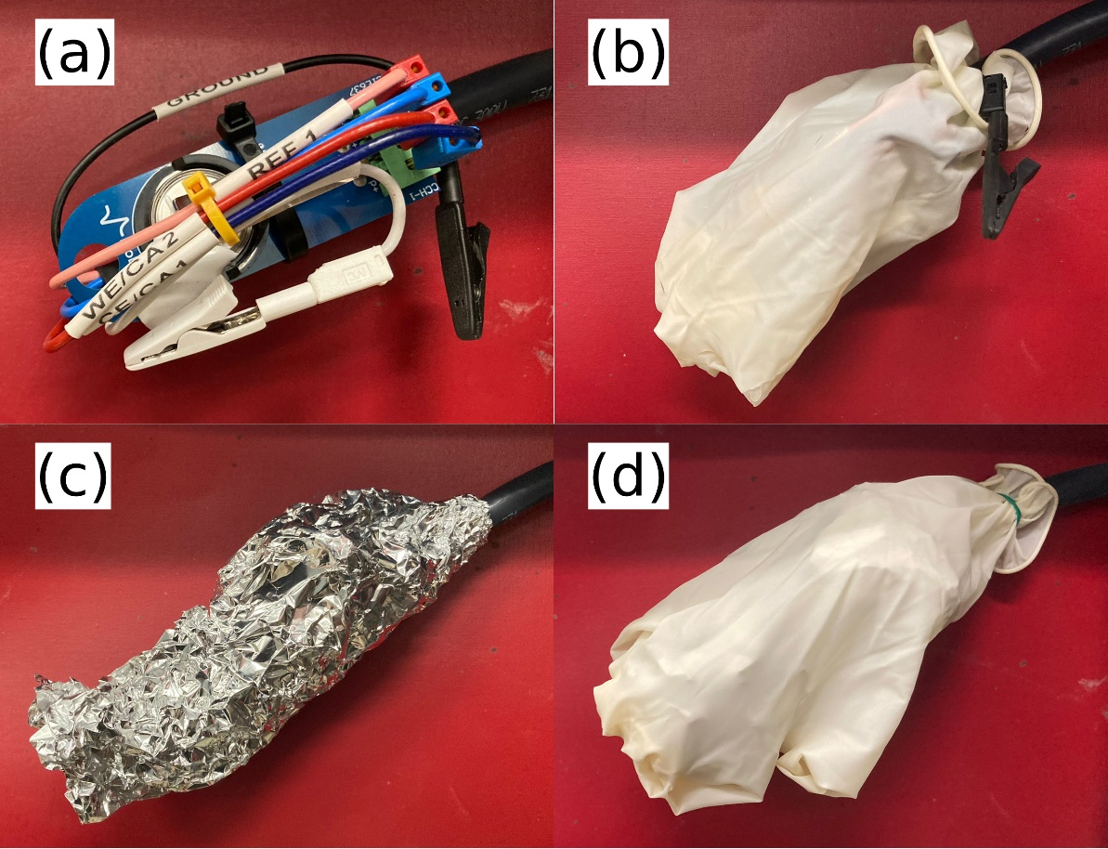
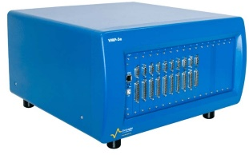
Cell Tester
BioLogic VMP-3e
Most cell tester requirements are easily achievable
Coin cell reference electrodes require complete shielding
Many cell testers qualify for everything except for rapid low current pulse initiation

Slide 10
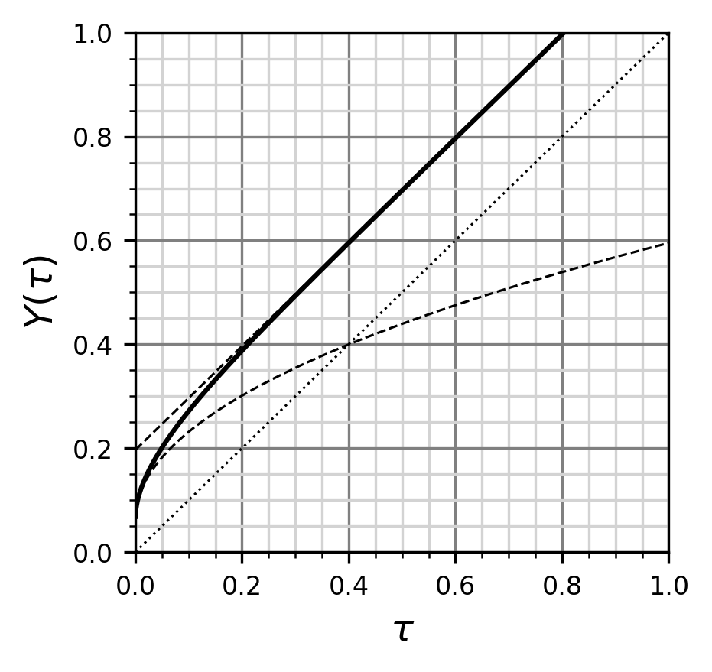
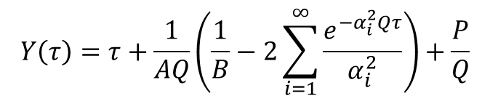
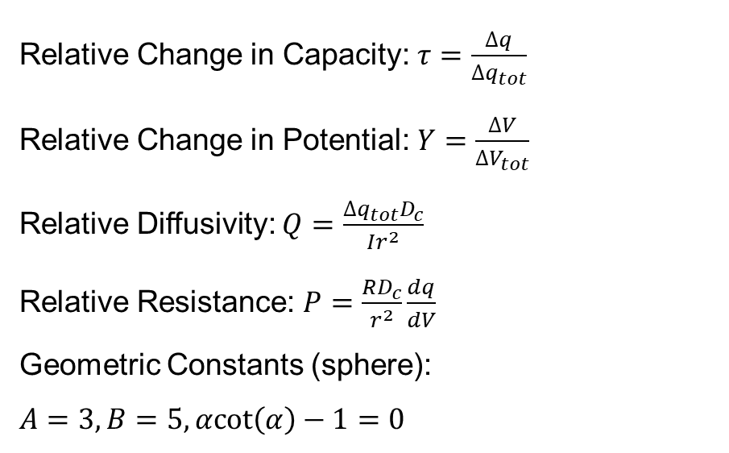

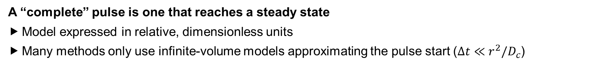
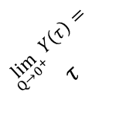
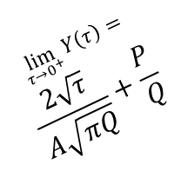
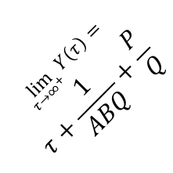
Model
$$Y\left(τ\right)=τ+\frac{1}{AQ}\left(\frac{1}{B}−2\sum_{i=1}^{∞}{\frac{e^{{−α}_{i}^{2}Qτ}}{α_{i}^{2}}}\right)+\frac{P}{Q}$$
$$Q=0.5, P={10}^{−1.5}$$
Relative Change in Capacity: $τ=\frac{∆q}{∆q_{tot}}$
Relative Change in Potential: $Y=\frac{∆V}{∆V_{tot}}$
Relative Diffusivity: $Q=\frac{∆q_{tot}D_{c}}{Ir^{2}}$
Relative Resistance: $P=\frac{RD_{c}}{r^{2}}\frac{dq}{dV}$
Geometric Constants (sphere):
$$A=3, B=5,α\text{cot}\left(α\right)−1=0$$
AMIDR
$$\lim_{τ→∞^{+}}{Y\left(τ\right)}=$$
$$τ+\frac{1}{ABQ}+\frac{P}{Q}$$
$$\lim_{Q→0^{+}}{Y\left(τ\right)}=$$
$$τ$$
Traditional GITT
$$\lim_{τ→0^{+}}{Y\left(τ\right)}=$$
$$\frac{2\sqrt{τ}}{A\sqrt{πQ}}+\frac{P}{Q}$$
A “complete” pulse is one that reaches a steady state
Model expressed in relative, dimensionless units
Many methods only use infinite-volume models approximating the pulse start ($∆t≪r^{2}/D_{c}$)

Slide 11
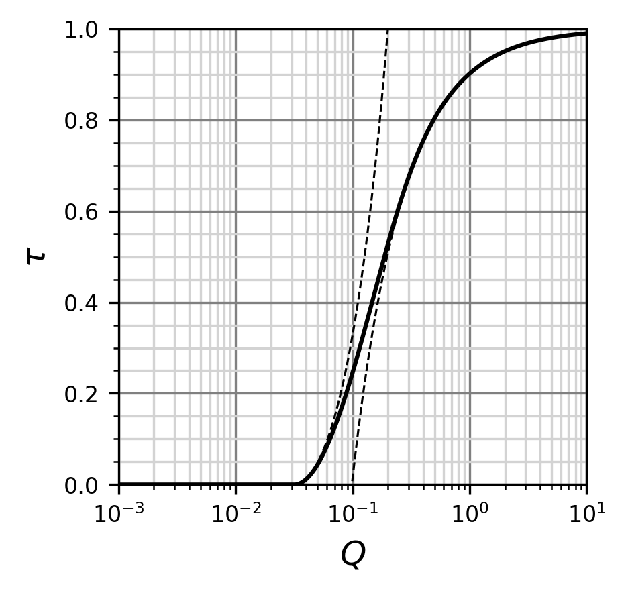


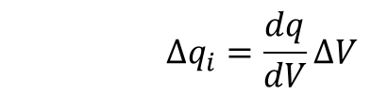
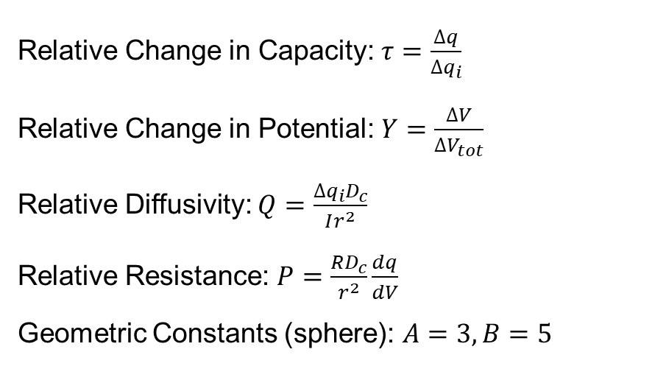
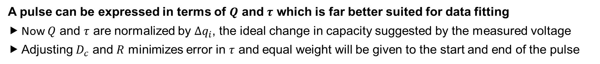

Model
$$Y\left(τ\right)=τ+\frac{1}{AQ}\left(\frac{1}{B}−2\sum_{i=1}^{∞}{\frac{e^{{−α}_{i}^{2}Qτ}}{α_{i}^{2}}}\right)+\frac{P}{Q}$$
$$∆q_{i}=\frac{dq}{dV}∆V$$
$$Y\left(τ\right)=1, P={10}^{−1.5}$$
Relative Change in Capacity: $τ=\frac{∆q}{∆q_{i}}$
Relative Change in Potential: $Y=\frac{∆V}{∆V_{tot}}$
Relative Diffusivity: $Q=\frac{∆q_{i}D_{c}}{Ir^{2}}$
Relative Resistance: $P=\frac{RD_{c}}{r^{2}}\frac{dq}{dV}$
Geometric Constants (sphere): $A=3, B=5$
$$\lim_{τ→0^{+}}{Y\left(τ\right)}=$$
$$\frac{2\sqrt{τ}}{A\sqrt{πQ}}+\frac{P}{Q}$$
$$\lim_{τ→∞^{+}}{Y\left(τ\right)}=$$
$$τ+\frac{1}{ABQ}+\frac{P}{Q}$$
A pulse can be expressed in terms of $Q$ and $τ$ which is far better suited for data fitting
Now $Q$ and $τ$ are normalized by $∆q_{i}$, the ideal change in capacity suggested by the measured voltage
Adjusting $D_{c}$ and $R$ minimizes error in $τ$ and equal weight will be given to the start and end of the pulse

Slide 12
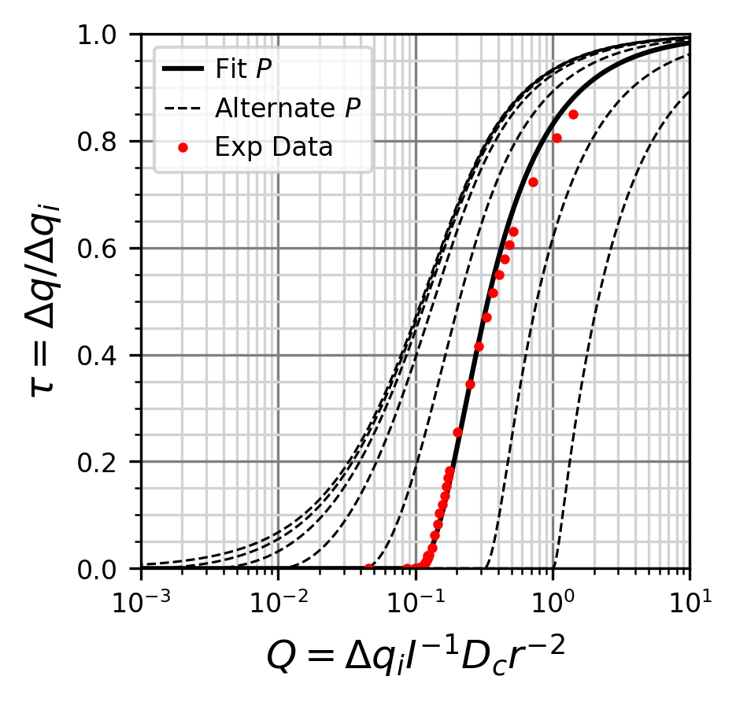
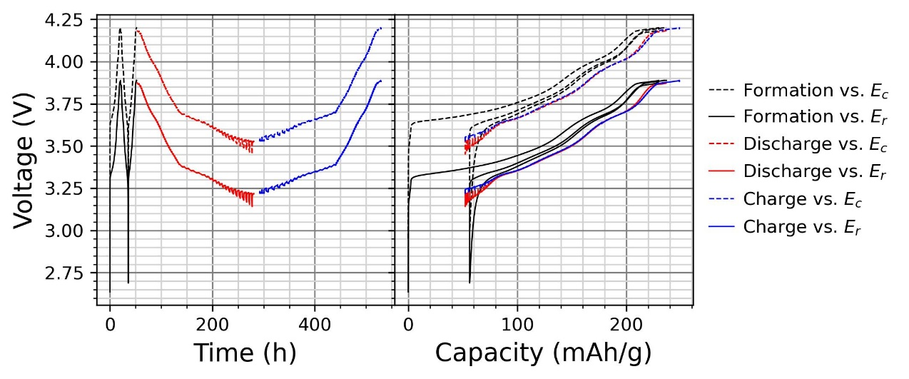

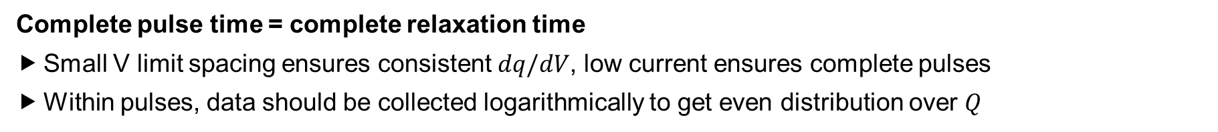
Protocol
$$Y\left(τ\right)=τ+\frac{1}{AQ}\left(\frac{1}{B}−2\sum_{i=1}^{∞}{\frac{e^{{−α}_{i}^{2}Qτ}}{α_{i}^{2}}}\right)+\frac{P}{Q}$$
$$I<0.5ABdq/dV{∆V}_{tot}D_{c}r^{−2}$$
Parameters | V Limit Spacing | Rate | Rest Time
4.2 – 3.7 V | 25 mV | C/40 | 1 hour
3.7 – 3.5 V | 25 mV | C/120 | 4 hour
3.5 – 3.7 V | 10 mV | C/300 | 4 hour
3.7 – 4.2 V | 25 mV | C/40 | 1 hour
NM9505
Complete pulse time = complete relaxation time
Small V limit spacing ensures consistent $dq/dV$, low current ensures complete pulses
Within pulses, data should be collected logarithmically to get even distribution over $Q$

Slide 13
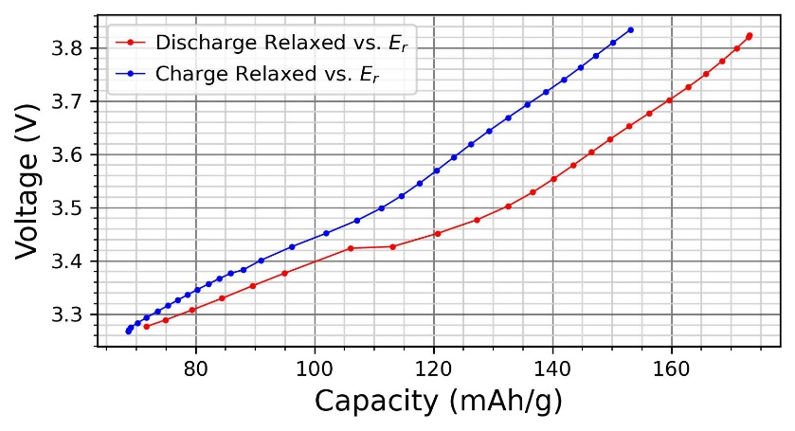
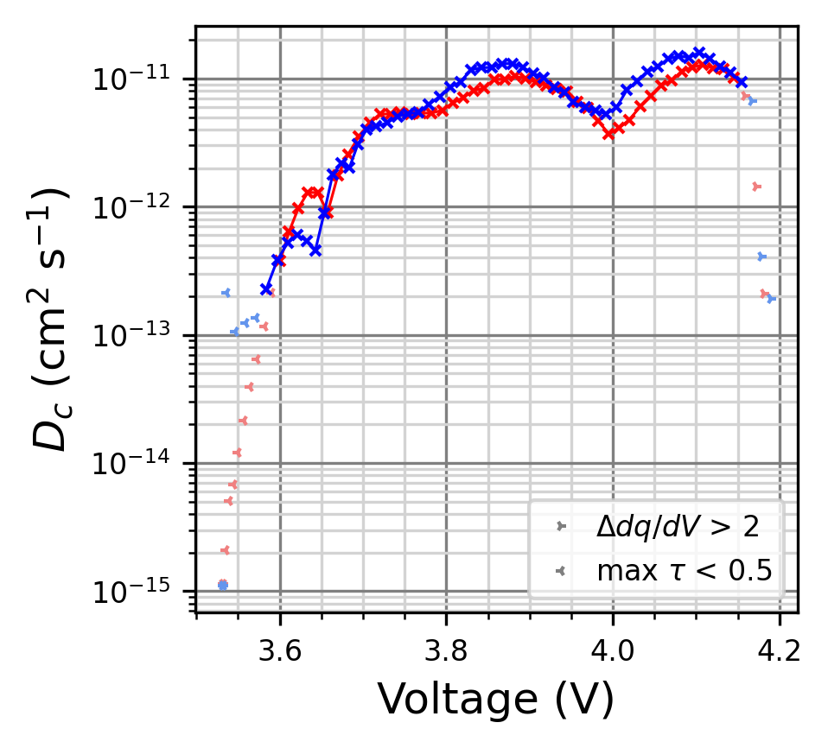

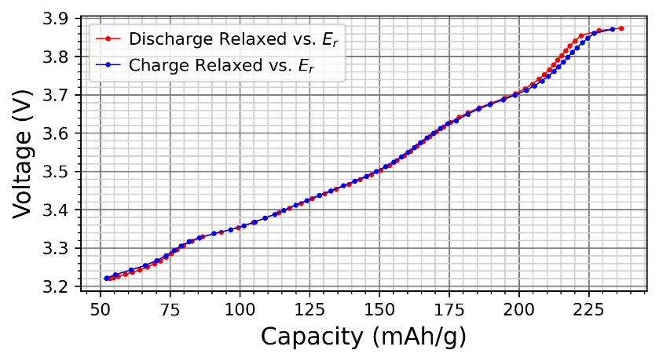

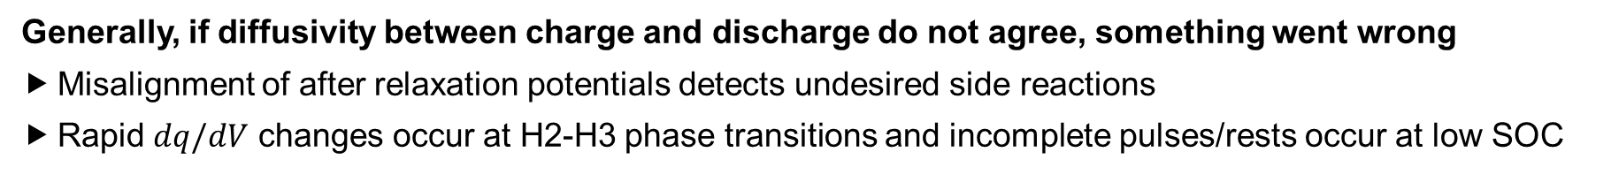
Error Management
NM9505
Dch
NMC811
Ch
NM9505
Generally, if diffusivity between charge and discharge do not agree, something went wrong
Misalignment of after relaxation potentials detects undesired side reactions
Rapid $dq/dV$ changes occur at H2-H3 phase transitions and incomplete pulses/rests occur at low SOC

Slide 14
Error Management
NM9505
Dch
Ch
Generally, if diffusivity between charge and discharge do not agree, something went wrong
Misalignment of after relaxation potentials detects undesired side reactions
Rapid $dq/dV$ changes occur at H2-H3 phase transitions and incomplete pulses/rests occur at low SOC
Figure adapted from [1] S. Kang and W. Chueh, “GITT Reinvented” J. Electrohem. Soc., 168, 120504 (2021)

Slide 15
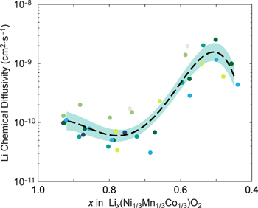
Error Management
NM9505
!
Dch
Ch
Generally, if diffusivity between charge and discharge do not agree, something went wrong
Misalignment of after relaxation potentials detects undesired side reactions
Rapid $dq/dV$ changes occur at H2-H3 phase transitions and incomplete pulses/rests occur at low SOC
Figures adapted from [1] S. Kang and W. Chueh, “GITT Reinvented” J. Electrohem. Soc., 168, 120504 (2021)

Slide 16
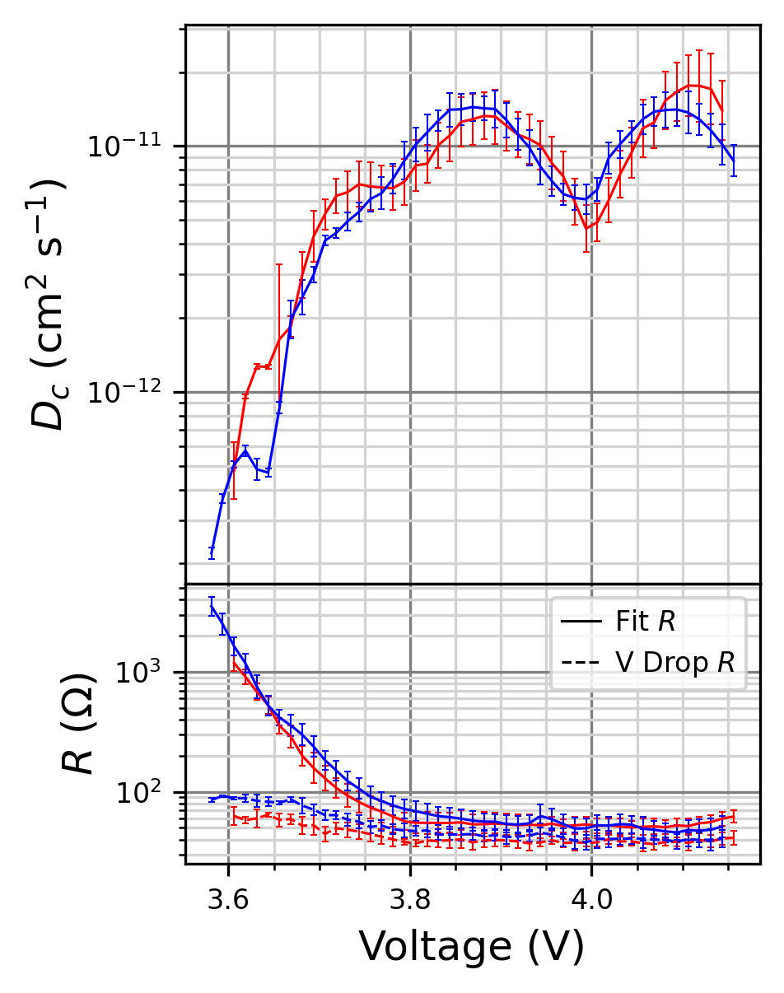
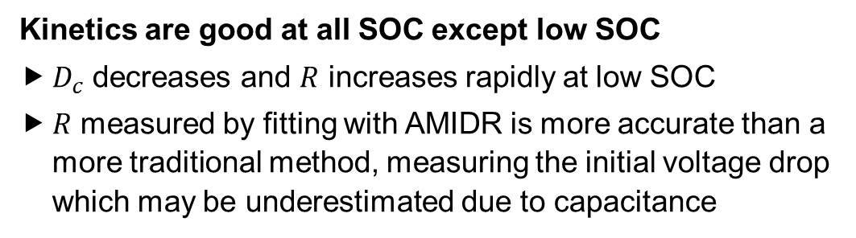
Results
NM9505
Dch
Ch
Kinetics are good at all SOC except low SOC
$D_{c}$ decreases and $R$ increases rapidly at low SOC
$R$ measured by fitting with AMIDR is more accurate than a more traditional method, measuring the initial voltage drop which may be underestimated due to capacitance

Slide 17
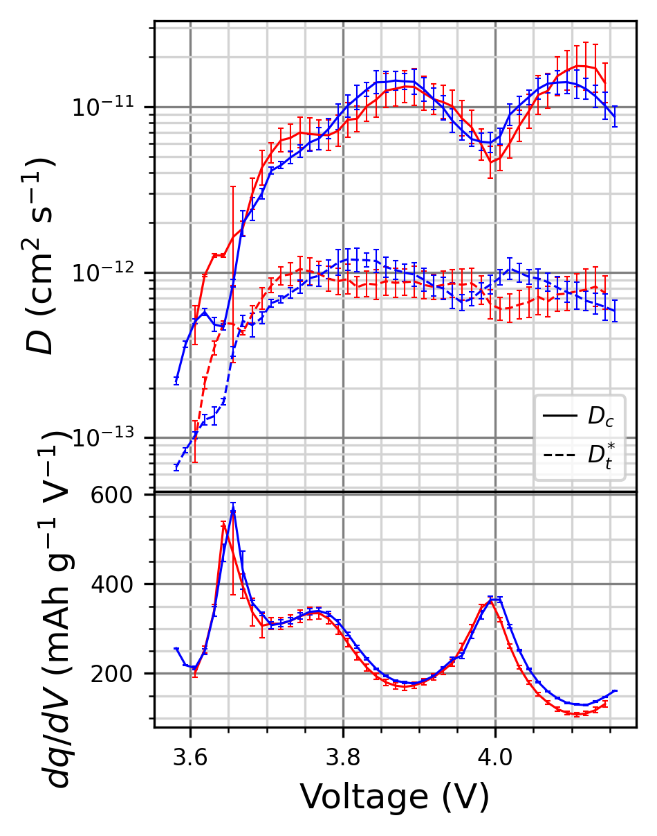
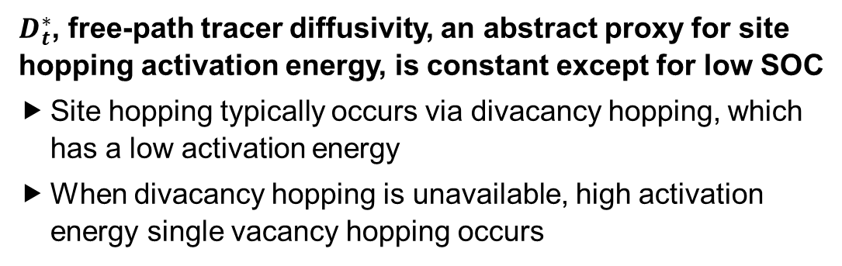
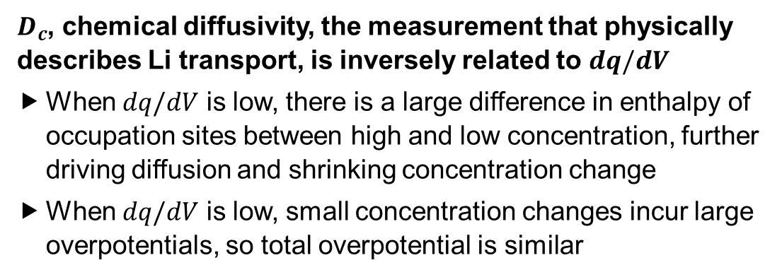
Results
NM9505
$D_{c}$, chemical diffusivity, the measurement that physically describes Li transport, is inversely related to $dq/dV$
When $dq/dV$ is low, there is a large difference in enthalpy of occupation sites between high and low concentration, further driving diffusion and shrinking concentration change
When $dq/dV$ is low, small concentration changes incur large overpotentials, so total overpotential is similar
Dch
Ch
$D_{t}^{∗}$, free-path tracer diffusivity, an abstract proxy for site hopping activation energy, is constant except for low SOC
Site hopping typically occurs via divacancy hopping, which has a low activation energy
When divacancy hopping is unavailable, high activation energy single vacancy hopping occurs

Slide 18
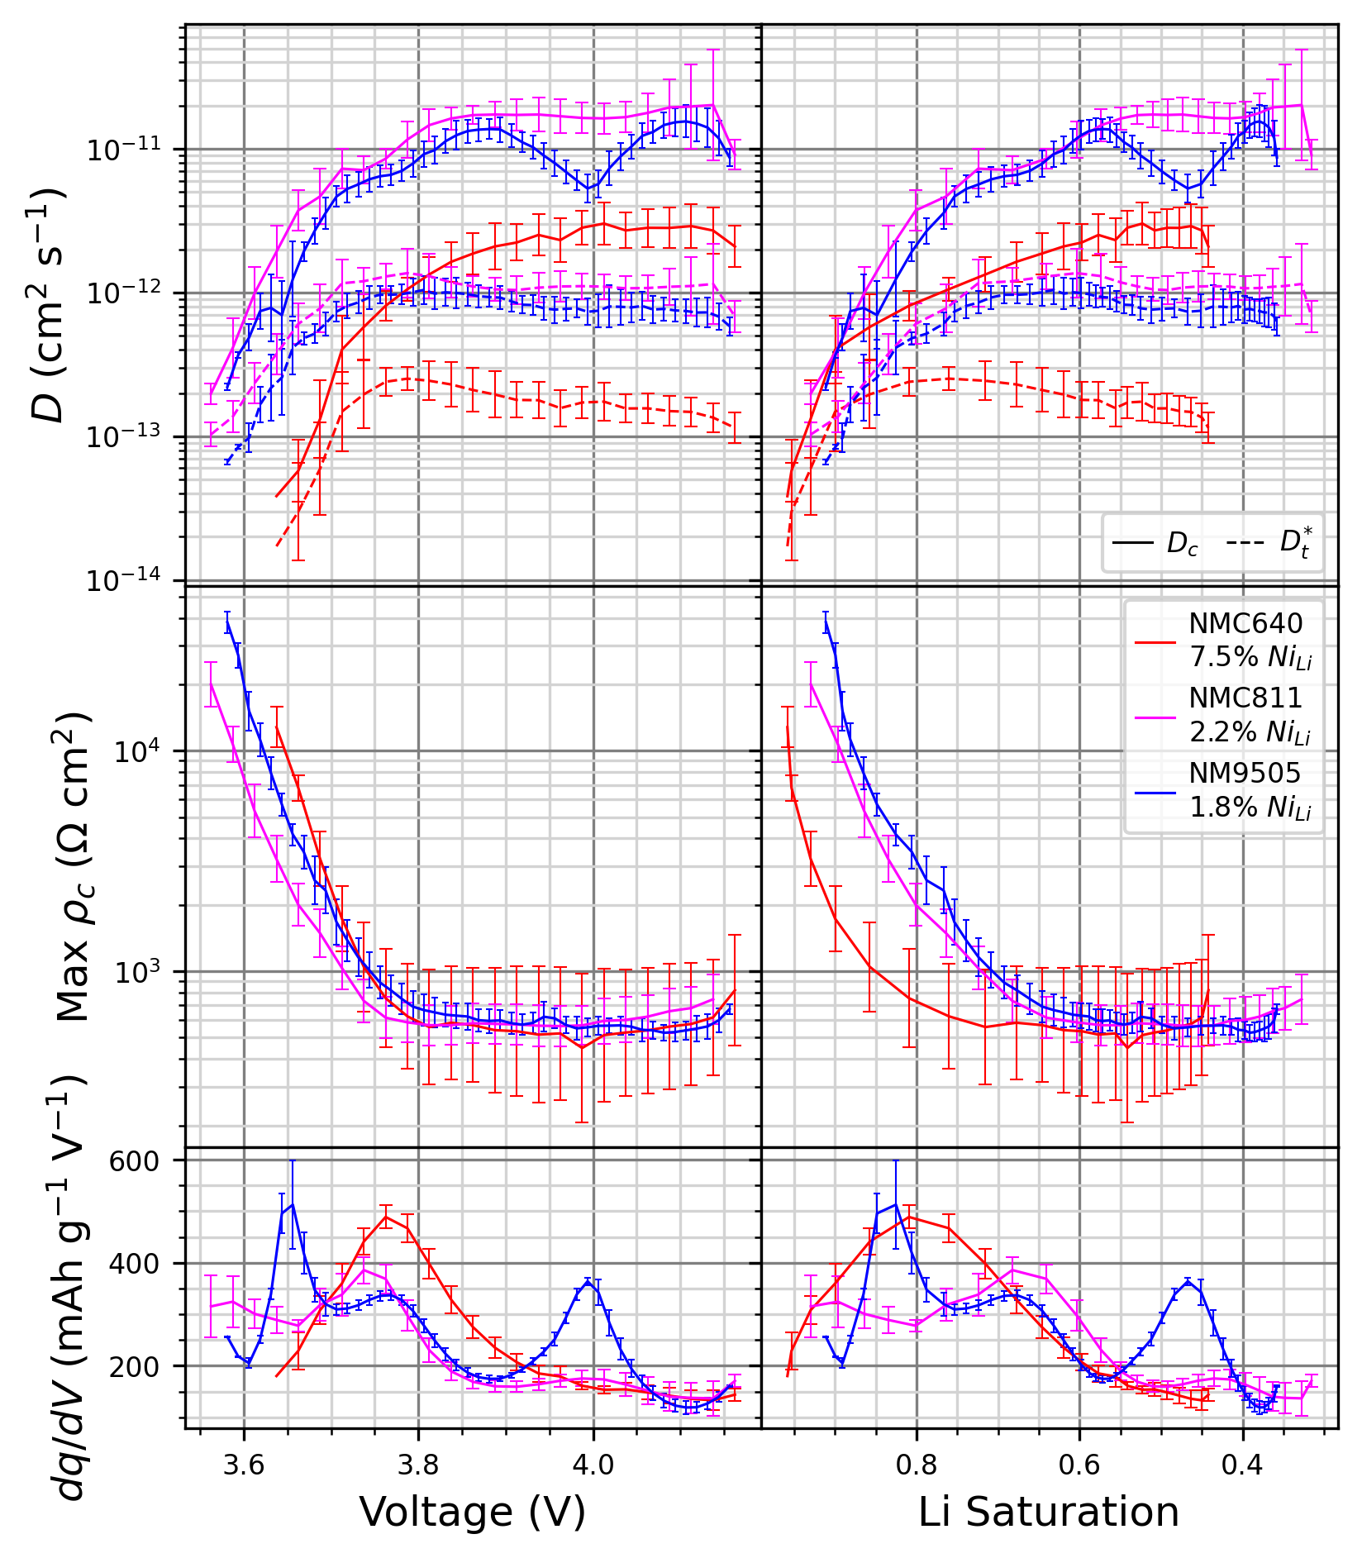
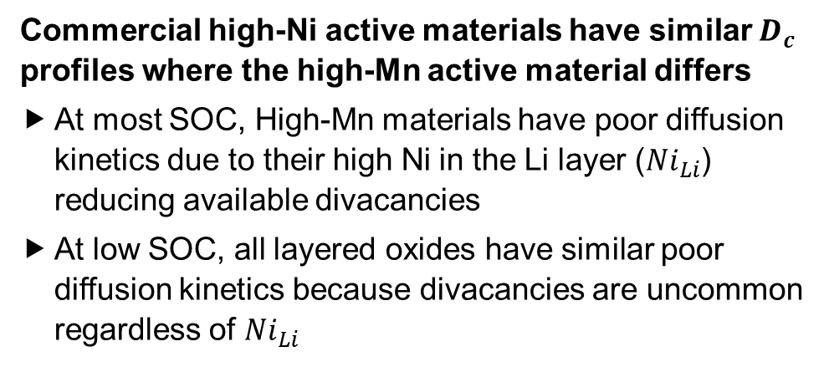
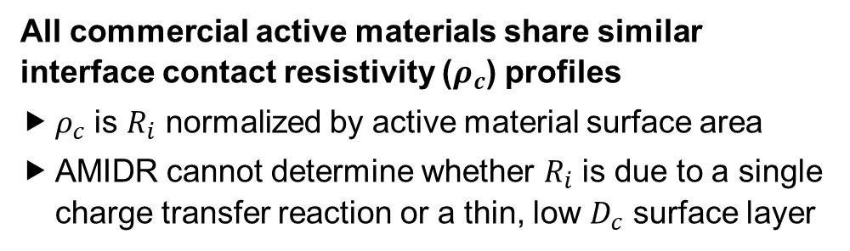
Results
Commercial high-Ni active materials have similar $D_{c}$ profiles where the high-Mn active material differs
At most SOC, High-Mn materials have poor diffusion kinetics due to their high Ni in the Li layer (${Ni}_{Li}$) reducing available divacancies
At low SOC, all layered oxides have similar poor diffusion kinetics because divacancies are uncommon regardless of ${Ni}_{Li}$
All commercial active materials share similar interface contact resistivity ($ρ_{c}$) profiles
$ρ_{c}$ is $R_{i}$ normalized by active material surface area
AMIDR cannot determine whether $R_{i}$ is due to a single charge transfer reaction or a thin, low $D_{c}$ surface layer

Slide 19
Conclusions
AMIDR is a powerful method and program available at github.com/MitchBall/AMIDR for reliably measuring active material diffusivity and interface resistance. Even if you don’t use AMIDR, helpful tips to improve your diffusivity measurements include:
Make cells with low mass loading to amplify diffusion impedance
Measure complete pulses to ensure relaxations are also complete
Measure both charge and discharge
Be rigorous!
Your measurement is only as good as your worst source of error
Model
Cell Design
Cell Tester
Error Management
Protocol

Slide 20
Future Work
Measure Na/K-ion active materials
Requires a Na/K-ion reference electrode
Calculate average site hopping activation energy
More tests must be performed at different temperatures
Better measure high $dq/dV$ regions (plateaus)
Will require more V accuracy, less sampling frequency, perhaps a different cell tester

Slide 21

Thanks!
Dahn-Yang-Metzger Lab Members
Questions?
The authors acknowledge Tesla Canada and NSERC for funding this work

Slide 22
References
[1] S. Kang and W. Chueh, “GITT Reinvented” J. Electrohem. Soc., 168, 120504 (2021)

Slide 23
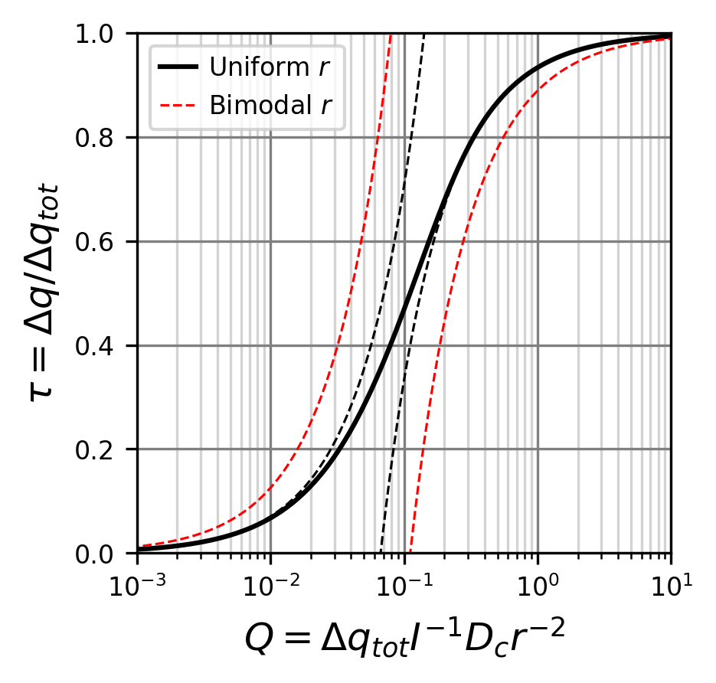
Particle Size Variation (Bonus)
AMIDR is robust against particle size variation
Exact model for bimodal material cannot be developed, but start and end approximations can
Particles of 1 and 3 arb. units in a 1:1 capacity ratio share a similar profile to a uniform model

Slide 24
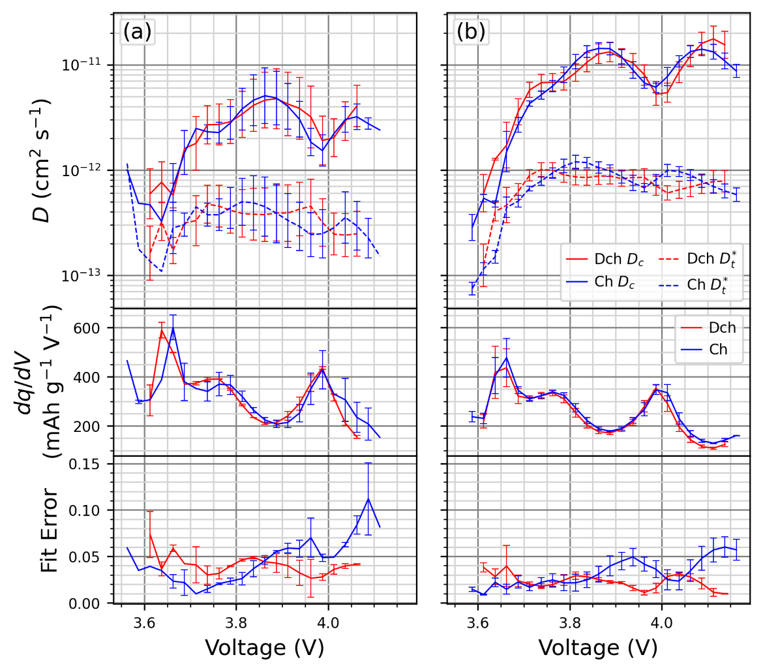
Charge/Discharge Disagreement (Bonus)
(a)
Parameters | V Limit Spacing | Rate | Rest Time
4.2 – 3.7 V | 25 mV | C/40 | 1 hour
3.7 – 3.5 V | 25 mV | C/120 | 4 hour
3.5 – 3.7 V | 25 mV | C/120 | 4 hour
3.7 – 4.2 V | 25 mV | C/40 | 1 hour
(b)
Parameters | V Limit Spacing | Rate | Rest Time
4.2 – 3.95 V | 12-13 mV | C/80 | 1 hour
3.95 – 3.7 V | 12-13 mV | C/80 | 1 hour
3.7 – 3.5 V | 12-13 mV | C/240 | 4 hour
3.5 – 3.7 V | 10 mV | C/300 | 4 hour
3.7 – 3.95 V | 12-13 mV | C/80 | 1 hour
3.95 – 4.2 V | 12-13 mV | C/80 | 1 hour
Limited charge/discharge disagreement is due to $dq/dV$ change
Reducing the V limit spacing reduces this error

Slide 25
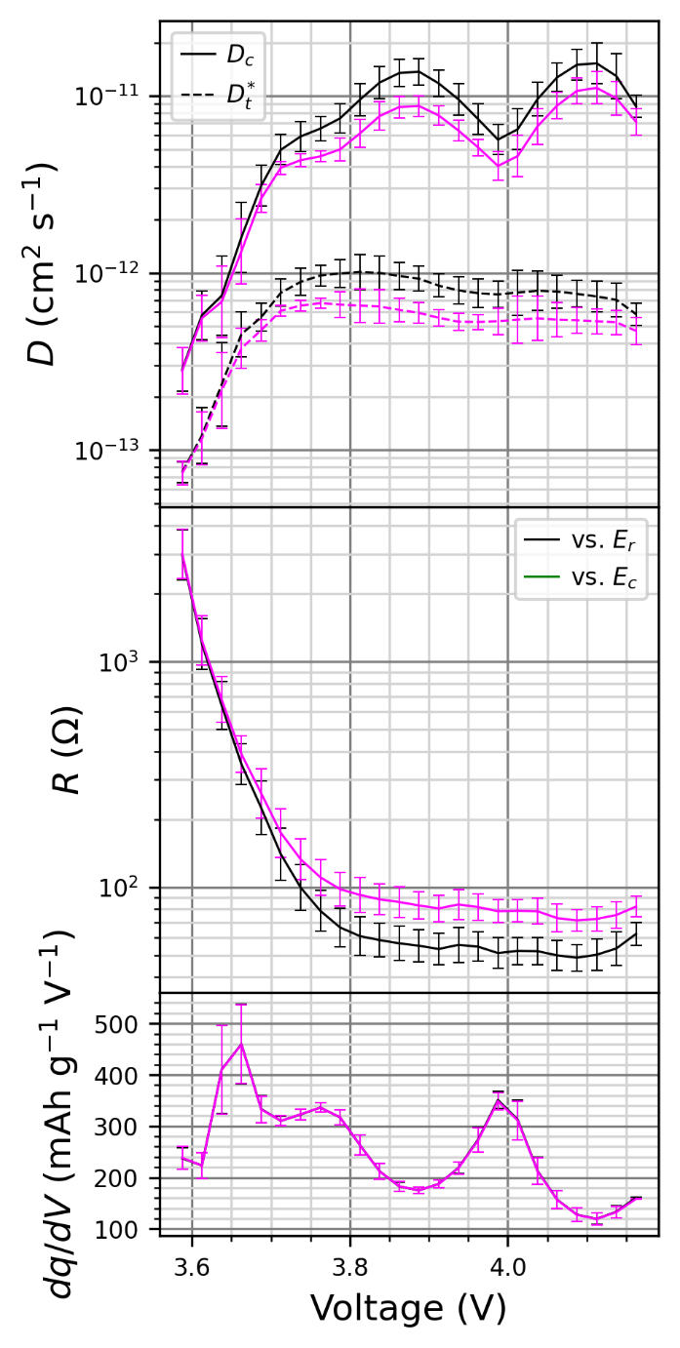
Anode Impedance (Bonus)
Some anode impedance may be acceptable, but its error is measurable
When cathode kinetics are poor, anode impedance is negligable

